Slide 1

CIU Lost & Found System
Team: Nikita Mavrodiy · Majd Bannoura · Ali Anas · Ramez Saad
Course: Software Design & Architecture — Cyprus International University
Notes:
Speaker note: “Hello — we are Ali, Majd, Nikita. Today we present our semester project idea: the CIU Lost & Found System.”

Slide 2
Problem We Observed (Starting observation)
We found headphones in the dorm
Reception had them, but couldn’t identify the owner
There was no single official place to report or search
People use many different messaging platforms
Conclusion:
Returning lost items at CIU is unclear, fragmented, and unreliable.
Notes:
So, returning lost items at CIU is difficult
We have a problem, we want solution

Slide 3
Idea (solution)
We believed a simple web-based system could solve this problem
One official place instead of many chats
Accessible to everyone with just a link
No need to install apps or join groups
Result:
We decided to explore this idea further by understanding who is involved.
Notes:
“Now we have the idea to solve the problem, but who needs the solution? Who is involved?”

Slide 4
Stakeholders We Identified
Students – lose and find items on campus
Teachers & staff – also lose personal belongings
(for example, losing flash drives)
Dorm reception – currently keep or receive found items
Security staff – deal with valuable or sensitive item
Important decision:
The problem is not limited to students, so the system should work for anyone at CIU.
Notes:
anyone at CIU - we can call them CIU-members. Now we talk with them

Slide 5
Choosing Requirement Elicitation Methods
Method |  | Reason
Interviews |  | Allows real experiences and open discussion
Observation |  | Shows how lost items are handled in reality
Questionnaires |  | Too early, users may not know what they want
Workshops |  | Hard to organize, too formal
Brainstorming |  | Risk of unrealistic ideas
Prototyping |  | No clear requirements yet
Background Reading |  | No existing system at CIU
Notes:
We choose what suits us here
Simple and realistic for a student project.
We talk with CIU members without predefined questions and observe current lost-item handling process

Slide 6
What We Learned (input for FR, NFR)
Simple access is crucial
  If reporting is difficult, people won’t report found items
Ownership verification is a major concern
  People are afraid that someone may falsely claim an item
Anonymity is important for finders
  Many people prefer to report items without being personally involved
Some people don’t want to touch or move found items
  They prefer reporting the location instead of taking responsibility
Lost items affect different groups
  Students, teachers, and staff all face this problem
Notes:
just 5 observations
Thats what we will use as an input for our functional and non-functional requirements.

Slide 7
Example structure (NOT final requirements yet):
[F1] Simple access is crucial
├──→ Requirement about easy reporting
└──→ Requirement about no registration
[F2] Ownership verification is a concern
└──→ Requirement about verification process
[F3] Anonymity is important
└──→ Requirement about anonymous reporting
[F4] People don’t want to move items
└──→ Requirement about reporting location only
[F5] Many groups lose items
└──→ Requirement about open access for all CIU members
Notes:
We have five finding - F1, F2, F3, F4, F5
We did not invent requirements — we extracted them from what we learned.
Here we show that we shall get these kinds of requirements from those 5 observations.

Slide 8
Locked Findings → Derived Requirements
F1. Simple access is crucial
FR-1: The system shall allow reporting a found item using a simple web link.
FR-2: The system shall allow reporting without mandatory registration.
Notes:
We want people to actually report items, so access must be quick and simple. Thats why we write these functional requirements here

Slide 9
Locked Findings → Derived Requirements
F2. Ownership verification is a serious concern
FR-3: The system shall support an ownership verification process before an item is returned.
NFR-1 (Security): The system shall reduce the risk of false ownership claims.
Notes:
Here we naturally get one functional + one non-functional requirement.
No invention — pure derivation.

Slide 10
Locked Findings → Derived Requirements
F3. Anonymity is important for finders
FR-4: The system shall allow users to report found items anonymously.
NFR-2 (Privacy): The system shall protect the identity of users who choose to remain anonymous
Notes:
This is about user comfort, not technology.

Slide 11
Locked Findings → Derived Requirements
F4. Some people do not want to touch or move found items
FR-5: The system shall allow reporting the location of a found item without taking possession of it.
Notes:
Very concrete requirement, directly from observation.

Slide 12
Locked Findings → Derived Requirements
F5. Lost items affect different groups
FR-6: The system shall be usable by any member of the CIU community.
NFR-3 (Accessibility): The system shall be accessible through a standard web browser.
Notes:
No roles yet, no admins yet — just who can use it.

Slide 13
Functional Requirements (FR)
(What the system must do)
FR-1: The system shall allow users to report a found item using a simple web link.
FR-2: The system shall allow users to report found items without mandatory registration.
FR-3: The system shall support an ownership verification process before an item is returned.
FR-4: The system shall allow users to report found items anonymously.
FR-5: The system shall allow reporting the location of a found item without taking possession of it.
FR-6: The system shall be usable by any member of the CIU community.
Notes:
Every requirement comes from something we observed. Nothing was added without a reason
PS: if someone ask, “why is the [Open Access for CIU Members] not a quality or NFR”, answer - “it will affect implementation, you’ll see it from diagrams

Slide 14
Non-Functional Requirements (NFR)
(How the system should behave)
NFR-1 – Security
  The system shall reduce the risk of false ownership claims.
NFR-2 – Privacy
  The system shall protect the identity of users who choose to remain anonymous.
NFR-3 – Accessibility
  The system shall be accessible through a standard web browser.
Notes:
These requirements describe constraints and qualities
Functional requirements described WHAT the system must do
But non-functional requirements describe HOW the system should BEHAVE
We separated them to make later planning and architecture decisions clearer.

Slide 15
From Functional Requirements to Product Backlog
Backlog Item | Related FRs | Priority | Reason
Report Found Item | FR-1, FR-2, FR-4 | High | Core action; must be easy & anonymous
Report Item Location Only | FR-5 | High | Many people don’t want responsibility
Public View of Items | (crucial for reporting) | High | Helps owners search
Ownership Verification | FR-3 | Medium | Prevents false claims
Open Access for CIU Members | FR-6 | Medium | Supports all user groups
Notes:
Functional requirements describe what the system must be able to do.
The product backlog groups these requirements into planned buildable features and orders them by importance.
Requirements = needs
Backlog = planned features
High priority = system is useless without it
We are not saying “we will code this first” — only “this matters most”.
”

Slide 16
Sprint Planning Assumptions
To keep things realistic and simple:
Sprint duration: 2 weeks
Team size: 4 members
Goal: Deliver working features per sprint
Notes:
We assume a standard 2-week sprint as commonly used in Scrum
Scrum helps us organize work and deliver features step by step, even before technical design decisions are made.

Slide 17
Sprint 1 Backlog (it’s gonna be revised later)
Sprint Goal
Enable basic reporting of found items with minimal effort
Sprint 1 Features:
Report Found Item
Report Item Location Only
Public View of Items
Notes:
Why these first:
Core system value
Allows immediate usage
No complex verification yet

Slide 18
Sprint 2 Backlog (it’s gonna be revised later)
Sprint Goal
Make the system trustworthy and safe.
Sprint 2 Features
Ownership Verification
Anonymous Reporting
Open Access for CIU Members
Notes:
Why second:
Depends on basic reporting
Improves trust and usability

Slide 19
Scrum Team
Member | Role | Responsibilities
Majd Bannoura | Product Owner | Defines requirements, prioritizes product backlog
Nikita Mavrodiy | Scrum Master | Guides Scrum process, ensures workflow
Ali Anas | Developer | Supports implementation planning & documentation
Ramez Saad | Developer | Supports implementation planning & documentation
Notes:
1 Product Owner → clear requirements ownership
1 Scrum Master → shows process understanding
2 Developers → realistic workload split

Slide 20
Inputs to Architecture Decisions (our NFR)
Security | Privacy | Accessibility
NFR1: The system shall reduce the risk of false ownership claims. | NFR2: The system shall protect the identity of users who choose to remain anonymous | The system shall be accessible through a standard web browser.
Influence on architecture:
Need for controlled workflows Verification logic separated from basic reporting | Careful handling of user data Separation between public data and private data | Web-oriented architecture Simple client–server interaction
Notes:
Architecture should be driven by quality requirements, not chosen randomly.
Based on our NFRs, we derived the following quality attributes:

Slide 21
What We Do NOT Prioritize (Yet)
High scalability
High performance
Complex integrations
Distributed systems
Notes:
Because the system is limited to a university campus, extreme scalability is not a primary concern. And nothing much points to other potential qualities

Slide 22
We considered three common architectures taught in software architecture courses:
Monolithic Architecture
harder to manage security and privacy logic.
No layers-> mixed. Less maintainable
Microservices Architecture - too complex
Layered Architecture (our choice):
We propose: presentation - application - buisness - data layers
Notes:
Microservices - too complex (and we dont need much scalability)
Monolithic Architecture - not so bad - just less suitable.
Layered Architecture - gives is our security, privacy, acessebility (and even simplicity)

Slide 23
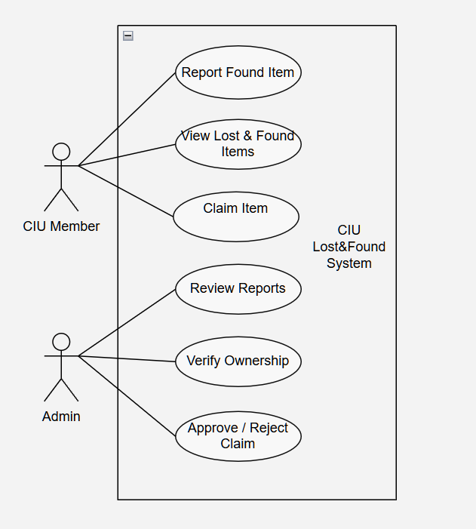
USE CASE DIAGRAM
Notes:
Clarified who interacts with the system and which actions are supported.
And, btw, from start, helped to realize that we need an “ admin “ in our system

Slide 24
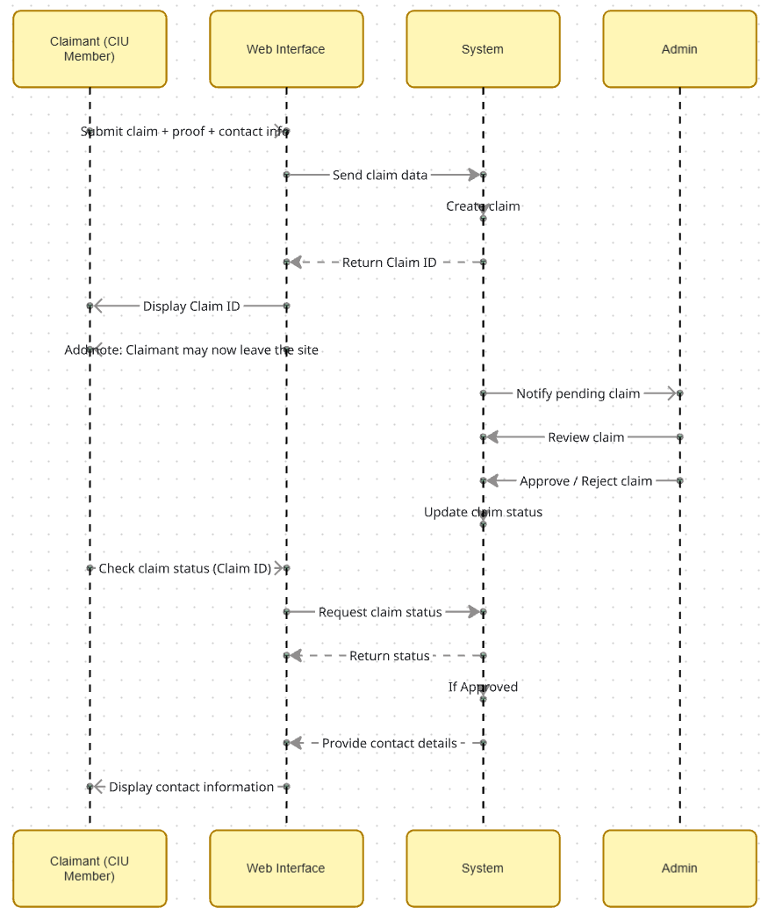
SEQUENCE
DIAGRAM
Notes:
Revealed the need for asynchronous approval, since users may leave the site before admin response
WE created claim reference ID that allows users to check the result later without requiring registration

Slide 25
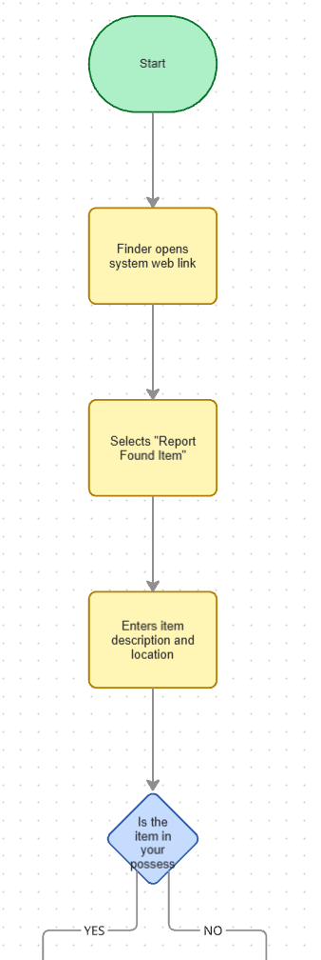
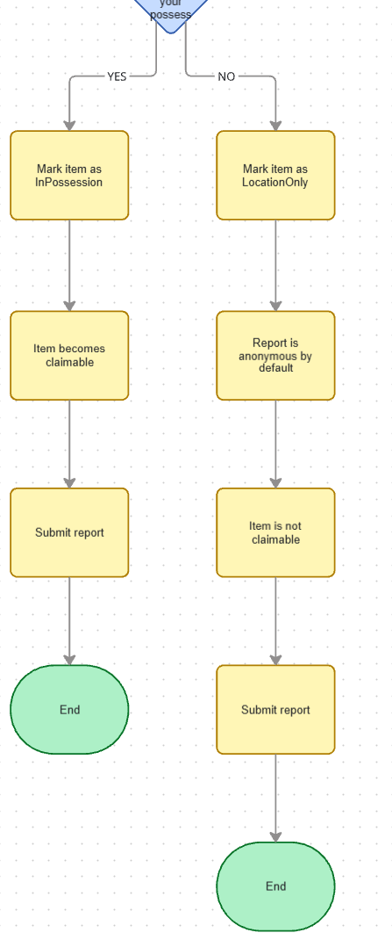
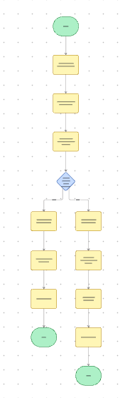
Activity Diagram 1 — Reporting a Found Item
Notes:
Helped us realize that many reports must be anonymous and not require item possession.

Slide 26
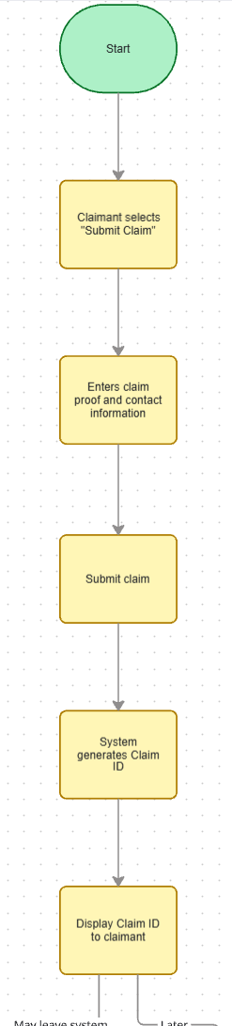
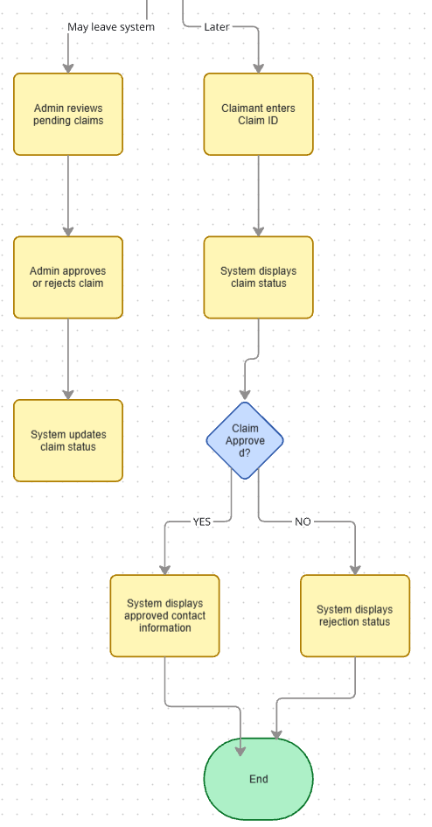
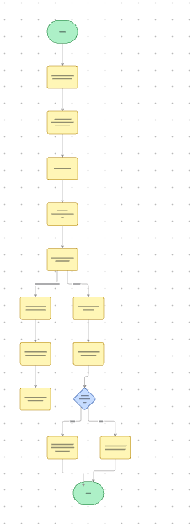
Activity Diagram 2 — Claiming an Item
Notes:
Clarified how admin approval and claim status check is handled

Slide 27
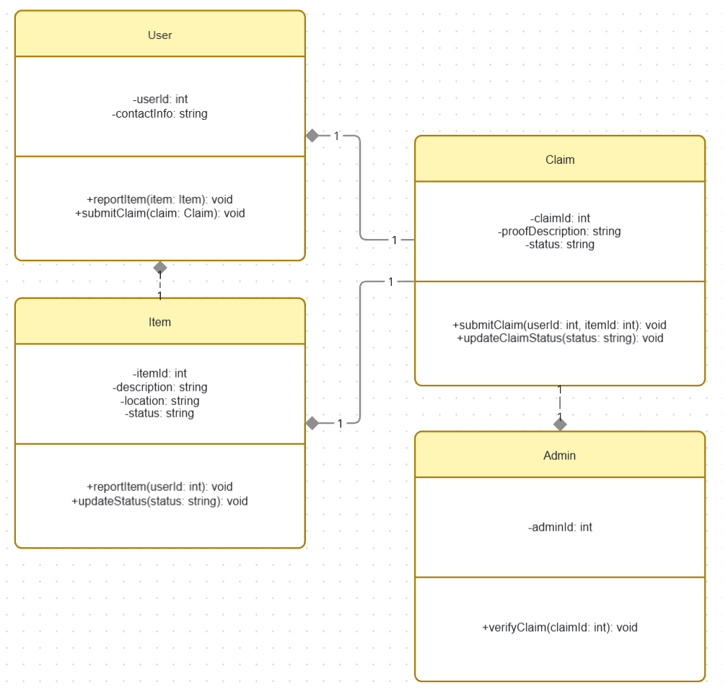
CLASS
DIAGRAM
Notes:
The class diagram Helped us define core entities and responsibilities while avoiding implementation details.

Slide 28
While creating diagrams, we revised some requirements and adjusted the sprint backlog
Sprint 1 – Core Flow
Report lost/found item
View item list
Basic item details & status
Sprint 2 – Claim & Verification
Submit claim with description
Admin review & decision
Claim status tracking
Sprint 3 – Control & Quality
Release contact info after approval
Basic usability & reliability requirements
Minor improvements based on feedback
We grouped features by dependency and risk
Notes:
While creating diagrams, we revised our sprint backlog

